Slide 1
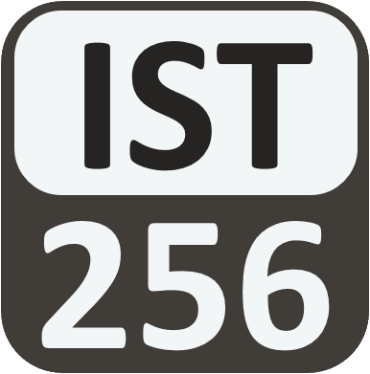
Lesson 01: Introduction to Programing
Topic: Introduction to Programming, Zybook Ch 1, P4E Ch 1. Slides on website.

Slide 2
Agenda
Diagnostic Quiz [Q02] Results
Programming: What, How and Why
Thinking Like a Programmer
The Python Programming Language
DEMO: The two ways we will code in this course
You’ve Read:
Zybook Ch1
P4E Ch1

Slide 3

Connect Activity
A sequence of instructions which when executed tell a computer what to do is called a:
Code
Algorithm
Program
Instruction Set

Slide 4
Programming
The What, How and Why

Slide 5
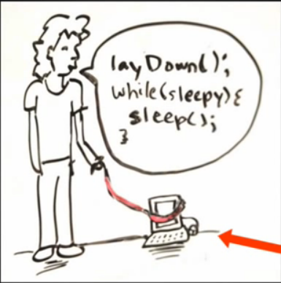
What is programming (a.k.a “Coding”)?
Programming is you commanding the computer to perform a series of tasks.
You must tell the computer exactly what you want it to do, in a way that it can understand.
The instructions we give a computer are called code or a program.
https://www.khanacademy.org/computing/computer-programming/programming/intro-to-programming/v/programming-intro

Slide 6
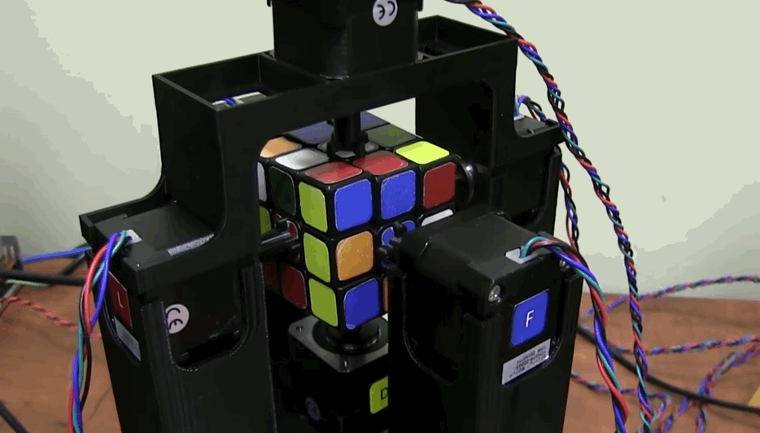
Programming is automated Problem Solving
https://encrypted-tbn3.gstatic.com/images?q=tbn:ANd9GcRGZ_XZJ0uoquXPD-217XjPn6rpN-4ljSnhQd4eYhBM1yWCYoIFBe2gdnU

Slide 7
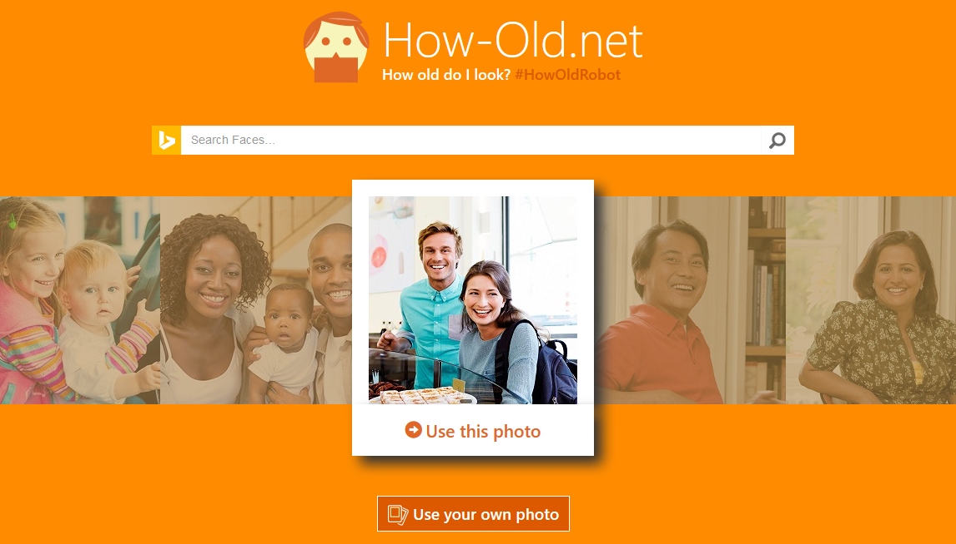
Visit Site

Slide 8
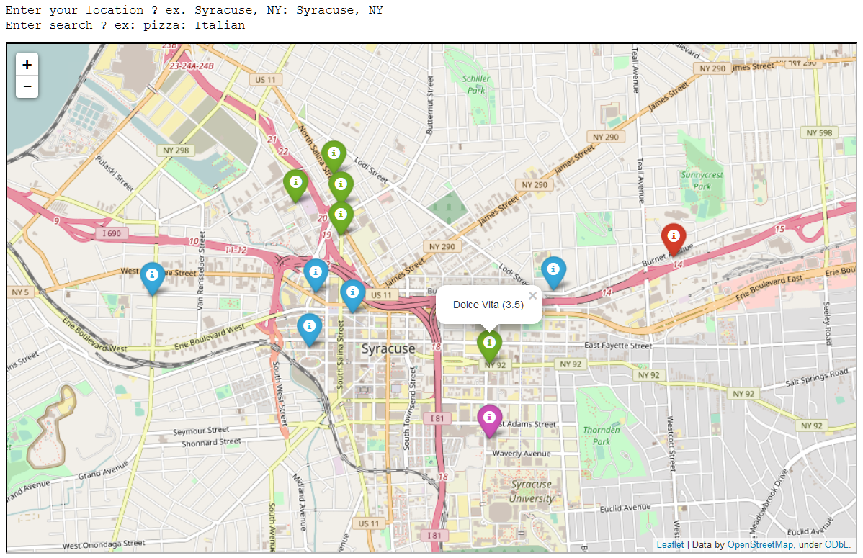

Slide 9
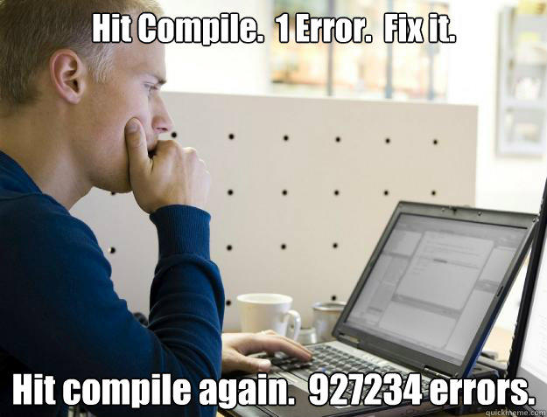
So, What makes programming difficult?
Syntax – learn how to communicate to the computer in a way it can understand.
Develop A Programmer’s Mindset –learn to think down at the computer’s level; solve problems on its terms.
Semantics – developing a design which matches your intent.

Slide 10
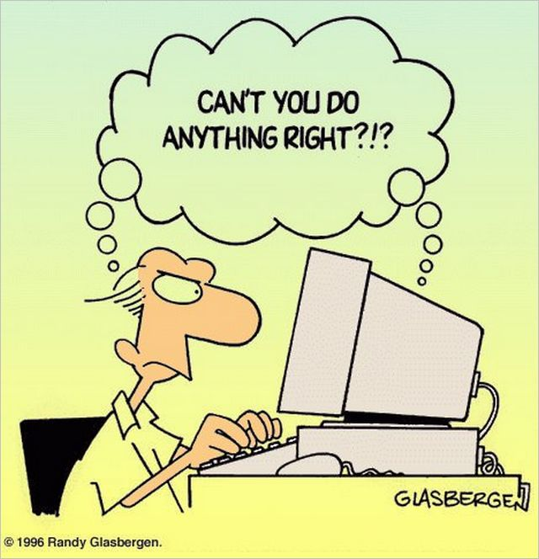
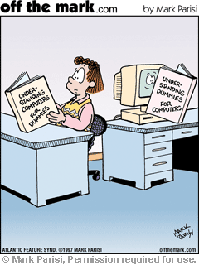
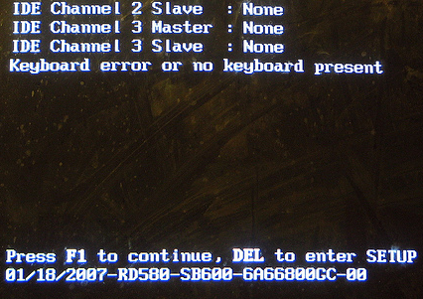
News Flash: In 2017, Computers are still stupid.
Computers are machines. They only do what they are instructed to do.

Slide 11
“Why Should I, A Non Computer Scientist, Learn To Program?”
To understand the capabilities and limitations of computers.
Be more productive in handling the data and information that we will encounter in our lives.
Solving Problems by thinking critically

Slide 12

Check Yourself!
Programming is difficult because:
It requires mathematics.
You must express your thoughts in way the computer can understand.
You must learn several programming languages.
All of the above.

Slide 13
Thinking Like a Programmer
Computational Thinking

Slide 14
Developing Your Programmer’s Mindset Requires:
Patience
Persistence
Precision

Slide 15
Algorithmic Thinking: Become a better problem solver
Algorithm – a series of steps or instructions which solve a problem or accomplish a task.
Think: “To-Do list”
Task Decomposition – an algorithmic approach where a complex task is defined as a series of detailed steps.
Think: “How-To Instructions”

Slide 16
How to Think Like a Programmer
Understand the problem you’re trying to solve.
Know your resources (inputs / outputs) and constraints.
Break up large problems into small ones.
Formulate a detailed plan with atomic steps.
Test and revise your strategy. Often.
It’s an iterative process, not a linear one.

Slide 17

The Path To Success
Is Littered With
Hundreds of Failures

Slide 18
Activity: Draw A Rectangle
Put these instructions in the proper order so that we draw a rectangle
Draw a 2 inch line to the right
Draw a 1 inch line up
Pencil down
Draw a 2 inch line to the left
Pencil up
Draw a 1 inch line down

Slide 19
Activity: Pick up the Ball
Need a 2 Volunteers
One writes the instructions provided by the class
One Executes the “Program”

Slide 20
Computers & Algorithmic Thinking
Most computer problems follow the input → Process → output model
Data: raw unprocessed facts
Information: meaningful, useful data
Input (Data)
Process (Program)
Output (Information)

Slide 21

Activity: Input or Output
For a program which counts how many people are in any given photo. What are the inputs and outputs?
The number of people in the photo
The photo itself

Slide 22
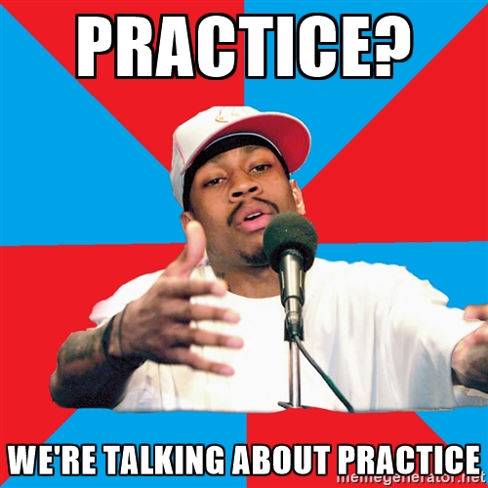
The secret to becoming a good programmer:

Slide 23
Let’s Talk Python…
(Now that you think like a programmer)

Slide 24
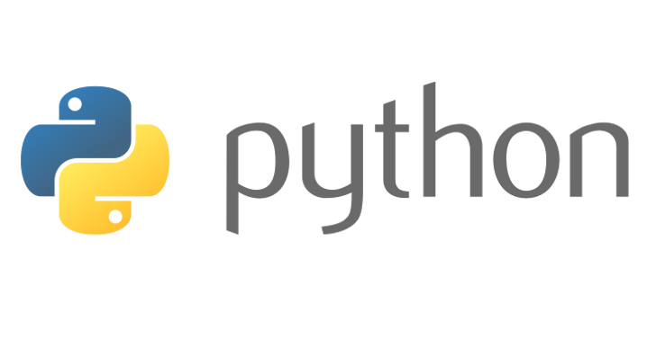
The Python Programming Language
Versatile Programming Language
Interpreted
High-Level
Expressive, powerful
Easy to Learn
Common Uses: Data Science, Web Development, Systems Automation
Not well suited for distribution such as Games or Mobile

Slide 25
A Brief History of Python
Developed in 1989 by Dutch programmer Guido van Rossum
Python 2 released in 2000, became a more collaborative open-source project.
2.7 The last release of python 2 was in 2010 support ends in 2018
Python 3 was released in 2008 and is not backwards compatible with python 2

Slide 26
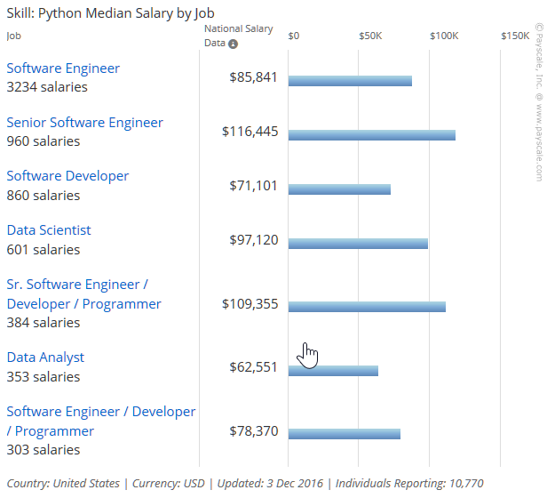
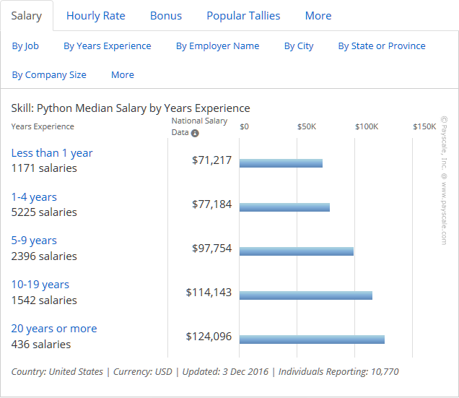
Python Jobs! (According to Payscale.com)

Slide 27
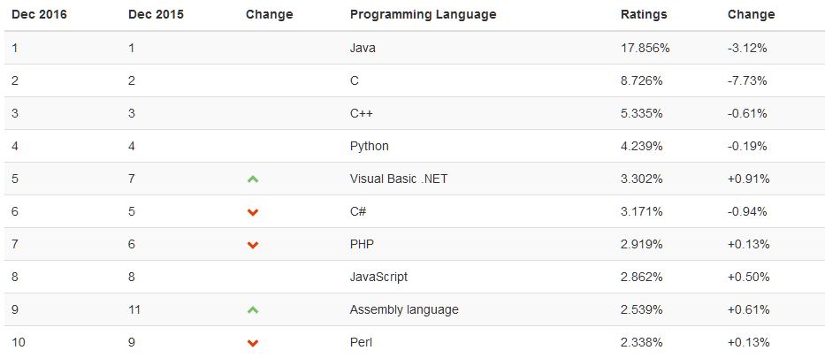
How Popular is Python? (TIOBE Index)

Slide 28
How We Code In This Course
"Understand how to code in teams, collaborate with others and manage source code."

Slide 29
Modern Programming is Collaborative:
Today's Programmer:
uses the command line to operate their computer.
uses git (or some other source code manager) manage their code.
writes code that is easily understood by others
can explain their code to others (including non-programmers)

Slide 30


We’ll Code Two Ways
Jupyter Notebook
Command Line w/IDLE
Intermix code with explanatory text and visualizations
Preferred tool of Data Analysts and Data Scientists
Most traditional way to code
Suitable for just about any purpose

Slide 31


We Use The Tools Programmers Use
Git
GitHub
Git is a tool for managing code.
You can easily track changes made over time.
GitHub is a website for storing git changes in the cloud.
We will use it for submitting work.

Slide 32
Demos: Git, Jupyter, IDLE, GitHub

Slide 33
1st In-Class Coding Lab & HW
After you finish the Walk-Through, Complete In-Class Coding Lab: Lesson 02
It takes 20-30 minutes to complete the lab.
Your lab must be checked in-class. Raise your had and ask to get your lab checked.
This is your responsibility. You will not receive credit outside of class.
After you complete the lab, start your Homework, due 1 week from today: NYC 1,2 and 4

Slide 34
In Class Coding Lab:
The goals of this lab are to help you to understand:
the Jupyter and IDLE programming environments
basic Python Syntax
variables and their use
how to sequence instructions together into a cohesive program
the input() function for input and print() function for output

